Slide 1
Airline Reservation System

Slide 2
We have tried to create an application that could help users to reserve tickets.
It could reserve ticket by passport number, name, email, mobile no. and destination.
Further it can display the records and delete it.

Slide 3
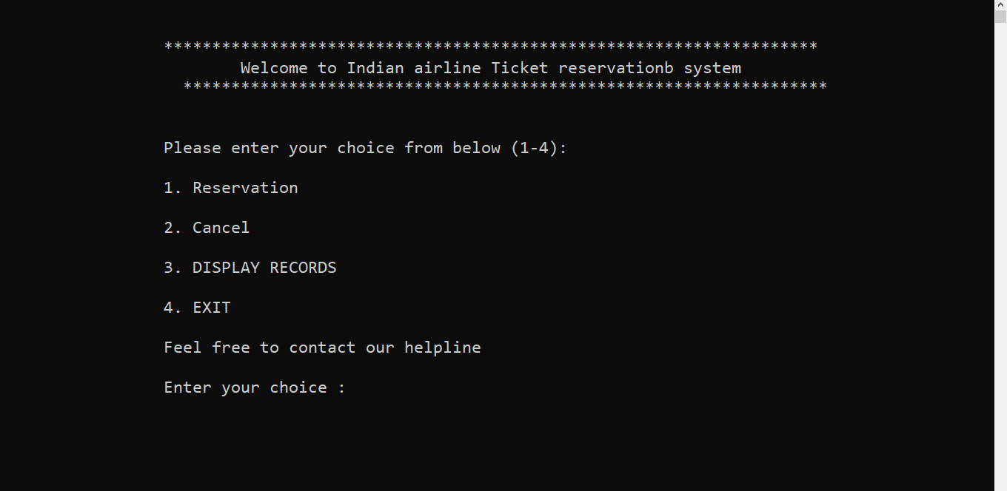
Features

Slide 4
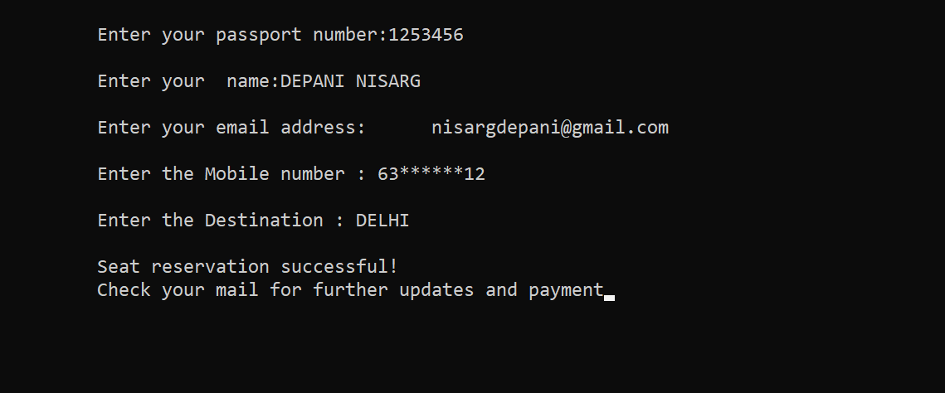
Reserve

Slide 5
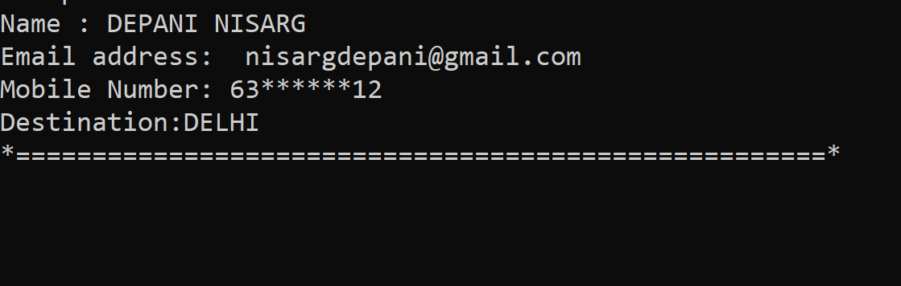
DISPLAY

Slide 6
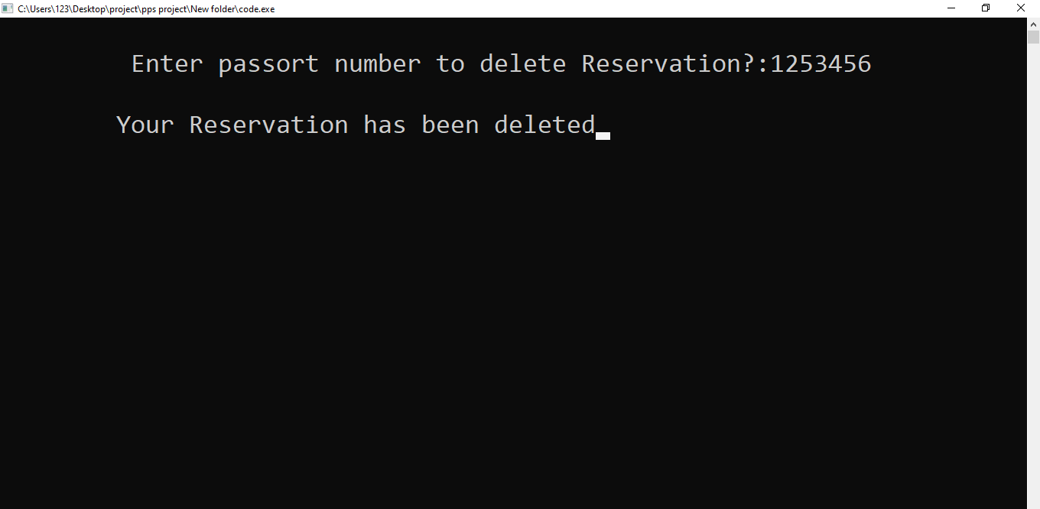
CANCEL

Slide 7
WHAT CAN FURTHER BE DONE
We could add covid status.
We could also add an option to alter the data.
We could ask for passengers need.
We could make an mobile app as laptop or computer is not available to all.
As beginners we could not do more but we could make it a booking system.

Slide 8
THANK YOU

